Slide 1
"Exploring Melanoma Demographics, causes, and treatments"

Slide 2
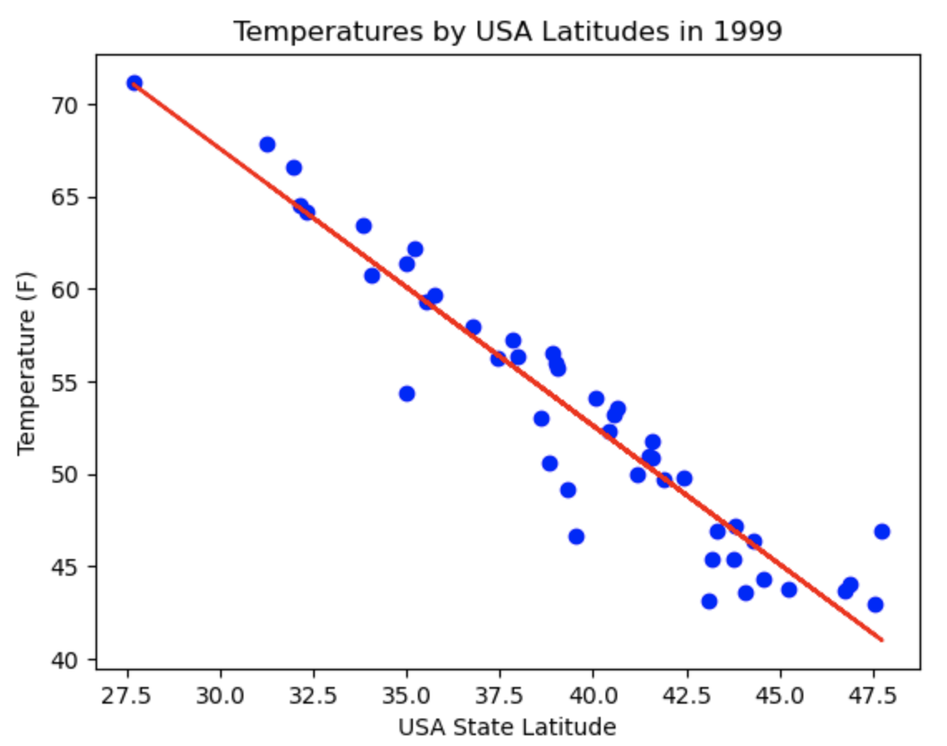
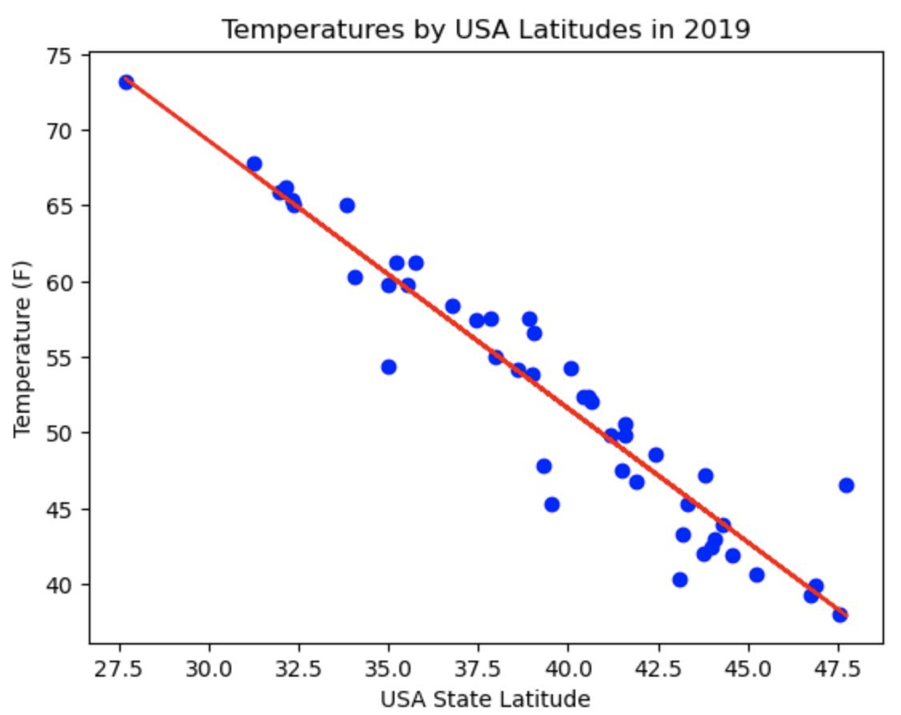
Testing to correlation between Melanoma Incidence and USA Latitude
Proving the relationship between Temperature and Latitude:
Lower Latitude (closer to the equator) correlates to a higher temperature.
The correlation between temperature and latitude is consistent between 1999 and 2019

Slide 3
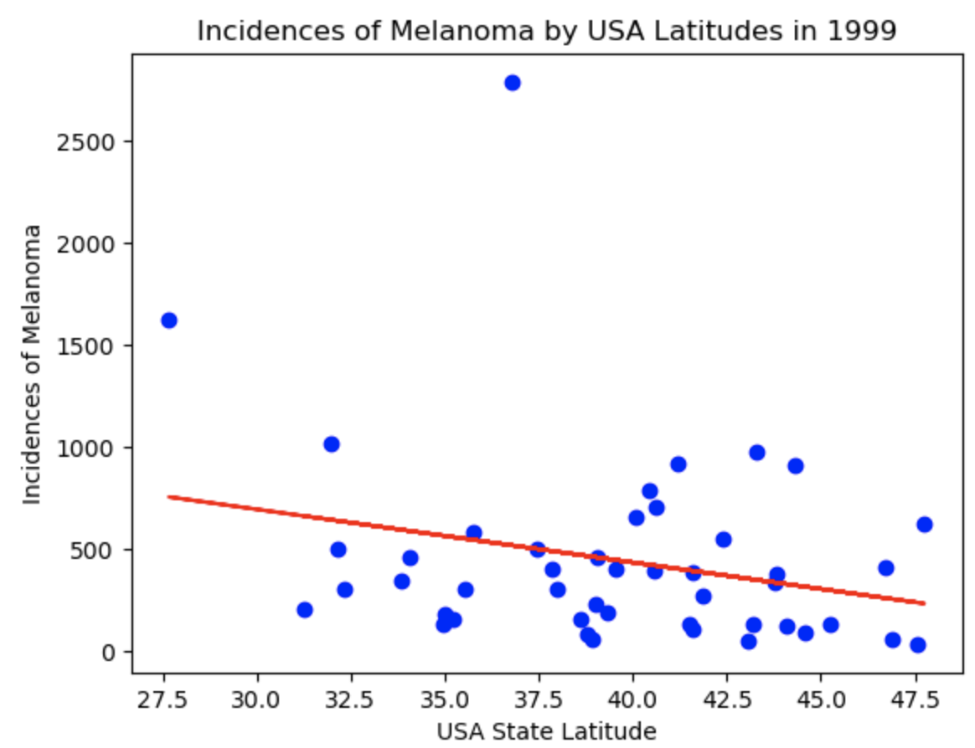
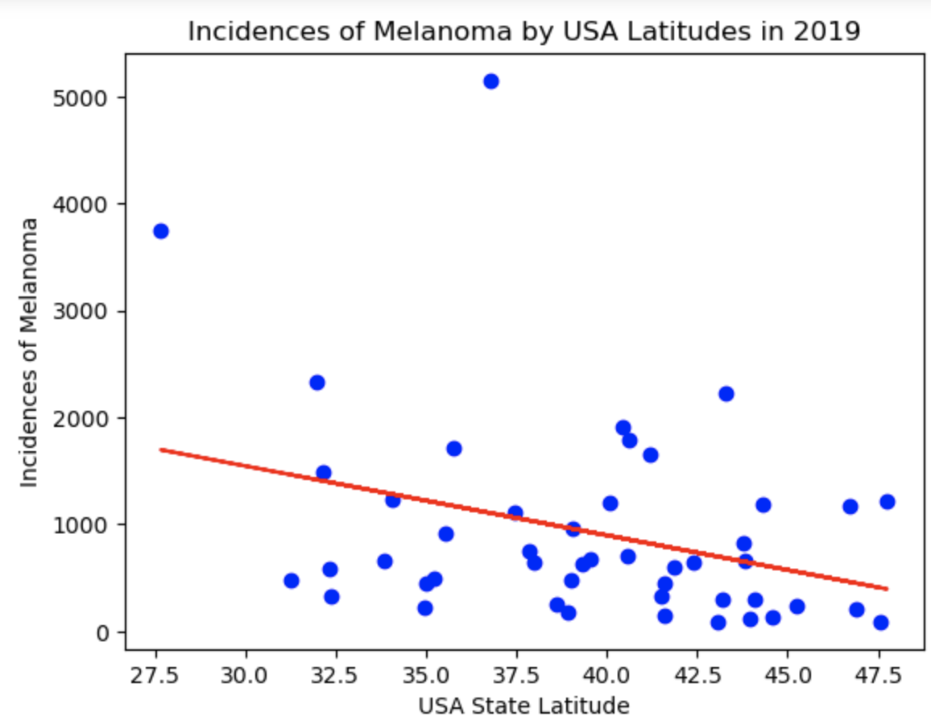
Testing to correlation between Melanoma Incidence and USA Latitude
Proving the relationship between Incidence of Melanoma and Latitude:
Lower Latitude (closer to the equator) correlates to a higher temperature.
The correlation between temperature and latitude is consistent between 1999 and 2019
y = -25.99x + 1472.06
Correlation Coefficient is -0.25579963641022196
R-squared is 0.06543345398760175
y = -64.84x + 3491.09
Correlation Coefficient is -0.3256846971959199
R-squared is 0.10607052198759805
In both 1999 and 2019, there is a low correlation coefficient between Melanoma incidence and Latitude: the R² is very low for both. Indicating that it is unlikely that someone’s latitude would contribute to their chance of getting Melanoma.
Independent T-test: p-value = 0.00277553

Slide 4
Results of Melanoma Incidence vs. Latitude
Null hypothesis: The means for the two populations are equal.
Alternative hypothesis: The means for the two populations are not equal.
Since the P-value for the incidences of melanoma is <= 0.05, we can reject that 1999 and 2019 have the same number of incidences of Melanoma. This means that the populations of 1999 and 2019 have differences in their incidences of Melanoma. So we can conclude that between these years there are factors that would have contributed to this change, but we are unable to prove that someone’s latitude is one of these contributing factors.

